Slide 1

Design and Implementation of Event Management System in SQL

Slide 2

Abstract
The Event Management System is a database project that helps to store and manage details of events, organizers, attendees, registrations, and sponsors. It enables organizers to plan and track events, allows attendees to register, and records sponsor contributions. The system makes event handling easier with the use of SQL for storing, retrieving, and analyzing data.

Slide 3
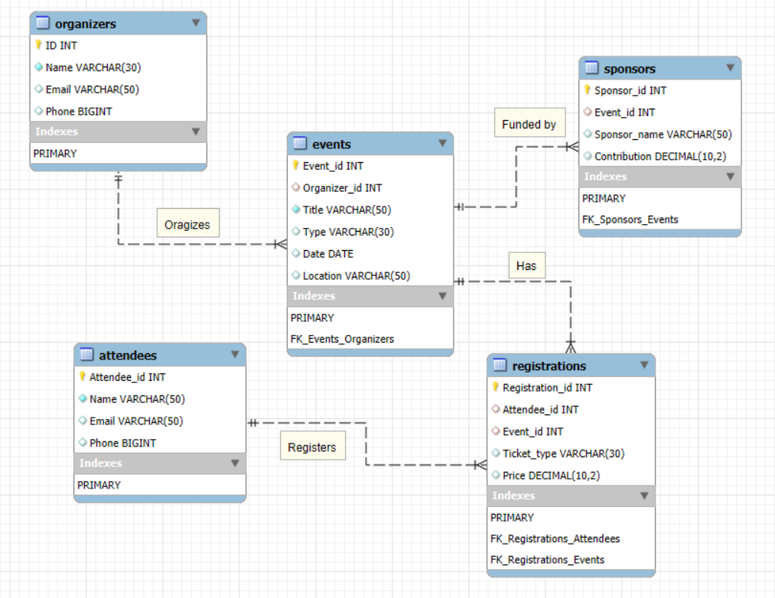
Entity Relationship Diagram

Slide 4
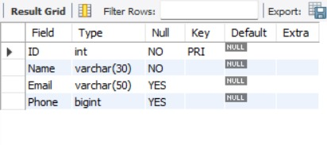
Organizers Table
This table provides details about the organizers.
It contains Organizer ID, Name, Email, and Phone.
Syntax: DESC Organizers;

Slide 5
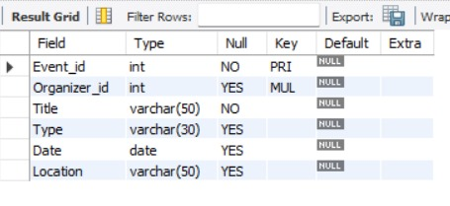
Events Table
This table provides details of the events.
It contains Event ID, Title, Type, Date, Location, and Organizer ID.
Syntax: DESC Events;

Slide 6
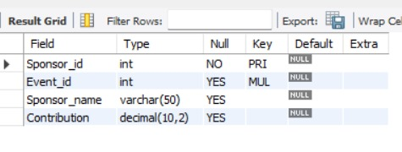
Sponsors Table
This table provides the sponsor details for events.
It contains Sponsor ID, Event ID, Sponsor Name, and Contribution.
Syntax: DESC Sponsors;

Slide 7
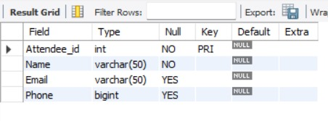
attendees Table
This table provides the details of attendees.
It contains Attendee ID, Name, Email, and Phone.
Syntax: DESC Attendees;

Slide 8
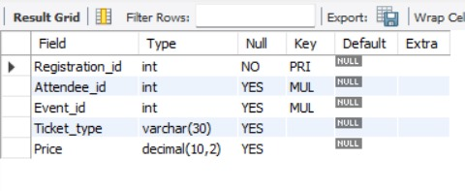
Registrations Table
This table provides the registration details of attendees for events.
It contains Registration ID, Attendee ID, Event ID, Ticket Type, and Price.
Syntax: DESC Registrations;

Slide 9
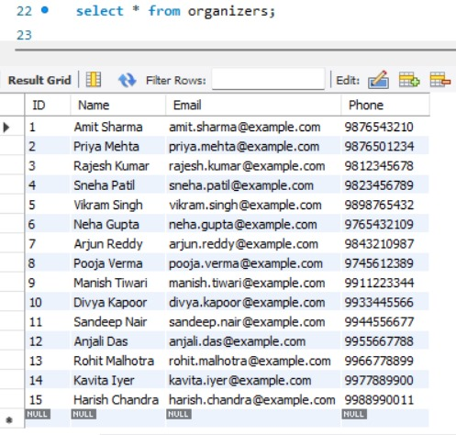
Contents of oraganizers Table

Slide 10
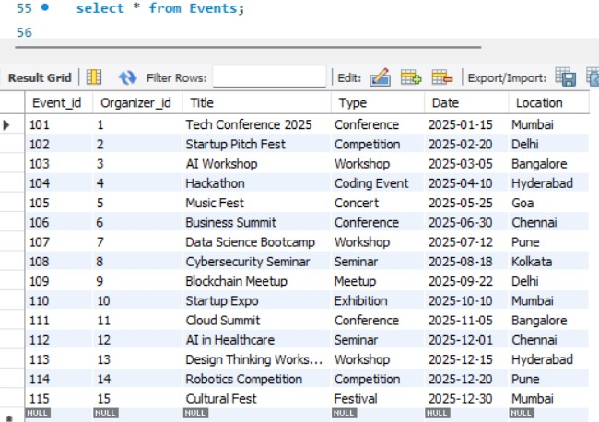
Contents of events Table

Slide 11
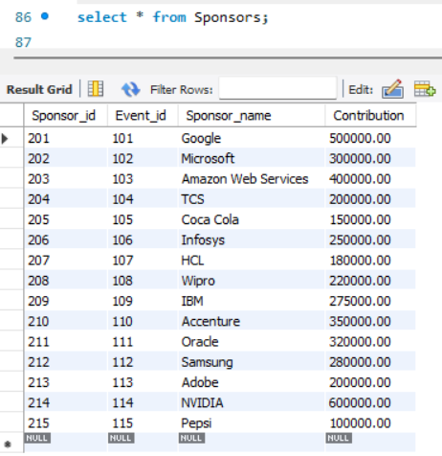
Contents of Sponsors Table

Slide 12
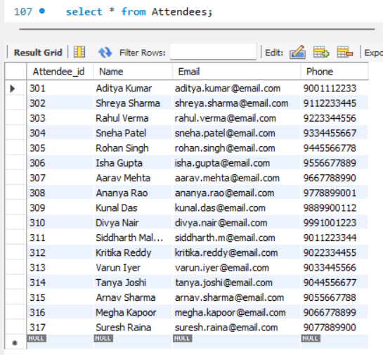
Contents of attendees Table

Slide 13
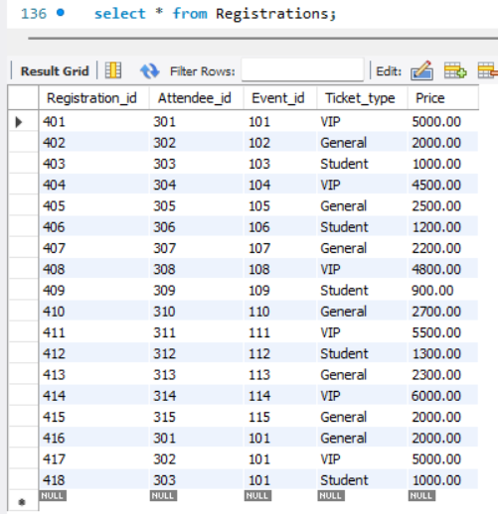
Contents of registrations Table

Slide 14

SUBQUERIES

Slide 15
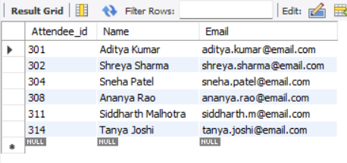
Find attendees who paid more than the average ticket price
Syntax:
SELECT Attendee_id, Name, EmailFROM AttendeesWHERE Attendee_id IN (SELECT Attendee_id FROM Registrations WHERE Price > (SELECT AVG(Price) FROM Registrations));

Slide 16
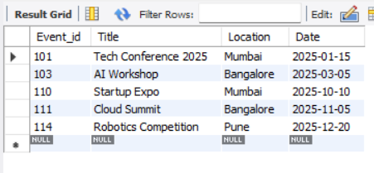
List events that have sponsors contributing above 5,00,000
Syntax:
SELECT Event_id, Title, Location, DateFROM EventsWHERE Event_id IN (SELECT Event_id FROM Sponsors WHERE Contribution > 300000);

Slide 17
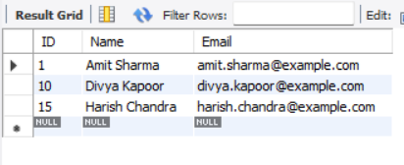
Find organizers who have at least one event in Mumbai
Syntax:
SELECT ID, Name, EmailFROM OrganizersWHERE ID IN ( SELECT Organizer_id FROM Events WHERE Location = 'Mumbai');

Slide 18
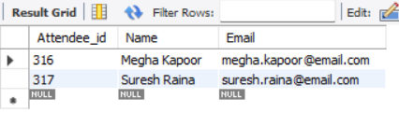
Get attendees who did not register for any event
Syntax:
SELECT Attendee_id, Name, EmailFROM AttendeesWHERE Attendee_id NOT IN ( SELECT DISTINCT Attendee_id FROM Registrations);

Slide 19
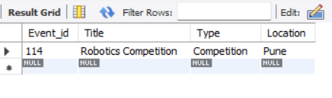
Find the most expensive event (based on max ticket price)
Syntax:
SELECT Event_id, Title, Type, LocationFROM EventsWHERE Event_id IN ( SELECT Event_id FROM Registrations WHERE Price = (SELECT MAX(Price) FROM Registrations));

Slide 20
JOINS

Slide 21
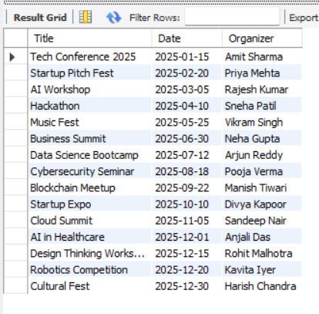
Display all events with their organizers (INNER JOIN)
Syntax:
SELECT e.Title, e.Date, o.Name AS OrganizerFROM Events eINNER JOIN Organizers o ON e.Organizer_id = o.ID;

Slide 22
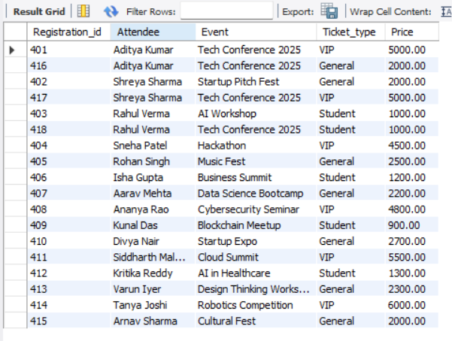
Show registrations with attendee names and event titles (INNER JOIN)
Syntax:
SELECT r.Registration_id, a.Name AS Attendee, e.Title AS Event, r.Ticket_type, r.PriceFROM Registrations rINNER JOIN Attendees a ON r.Attendee_id = a.Attendee_idINNER JOIN Events e ON r.Event_id = e.Event_id;

Slide 23
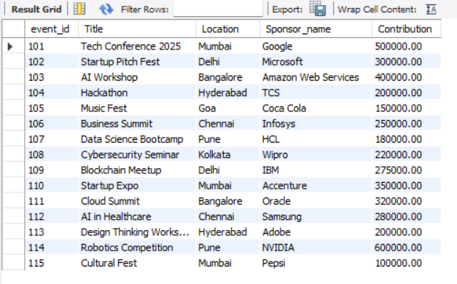
List all events and their sponsors (LEFT JOIN – even if no sponsor)
Syntax:
SELECT e.event_id, e.Title, e.Location, s.Sponsor_name, s.ContributionFROM Events eLEFT JOIN Sponsors s ON e.Event_id = s.Event_id;

Slide 24
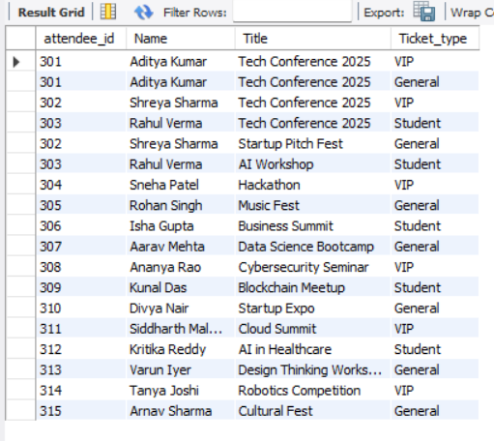
Find attendees and the events they registered for (RIGHT JOIN)
Syntax:
SELECT a.attendee_id, a.Name, e.Title, r.Ticket_typeFROM Registrations rRIGHT JOIN Attendees a ON r.Attendee_id = a.Attendee_idRIGHT JOIN Events e ON r.Event_id = e.Event_id;

Slide 25
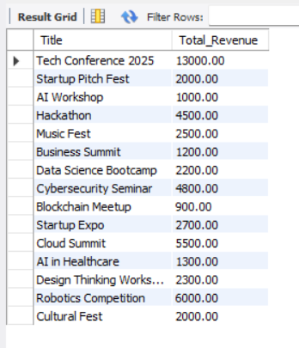
Display total revenue per event using JOIN + GROUP BY
Syntax:
SELECT e.Title, SUM(r.Price) AS Total_RevenueFROM Events eJOIN Registrations r ON e.Event_id = r.Event_idGROUP BY e.Title;

Slide 26
Display total revenue per event using JOIN + GROUP BY
Syntax:
SELECT e.Title, SUM(r.Price) AS Total_RevenueFROM Events eJOIN Registrations r ON e.Event_id = r.Event_idGROUP BY e.Title;

Slide 27
views

Slide 28
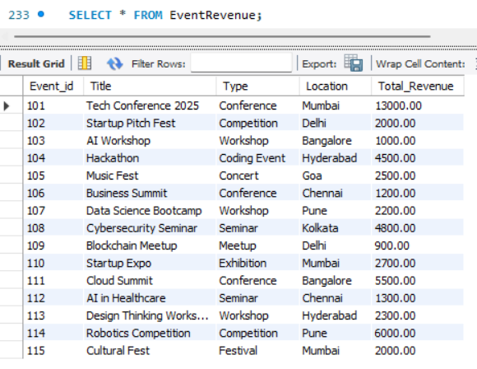
Create view as EventRevenue
Syntax:
CREATE VIEW EventRevenue ASSELECT e.Event_id, e.Title, e.Type, e.Location, SUM(r.Price) AS Total_RevenueFROM Events eJOIN Registrations r ON e.Event_id = r.Event_idGROUP BY e.Event_id, e.Title, e.Type, e.Location;

Slide 29
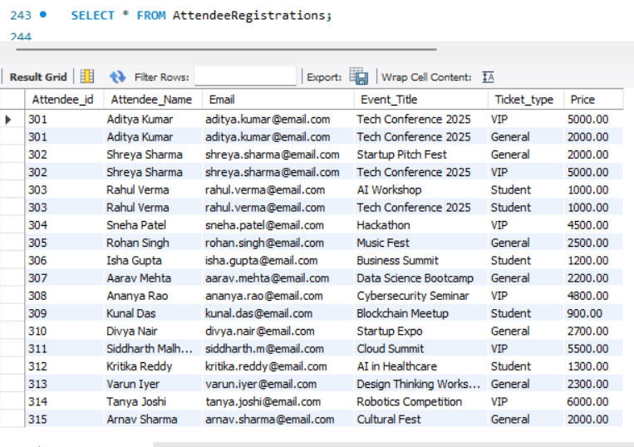
Create view as EventRevenue
Syntax:
CREATE VIEW EventRevenue ASSELECT e.Event_id, e.Title, e.Type, e.Location, SUM(r.Price) AS Total_RevenueFROM Events eJOIN Registrations r ON e.Event_id = r.Event_idGROUP BY e.Event_id, e.Title, e.Type, e.Location;

Slide 30

THANK YOU !

